Slide 1
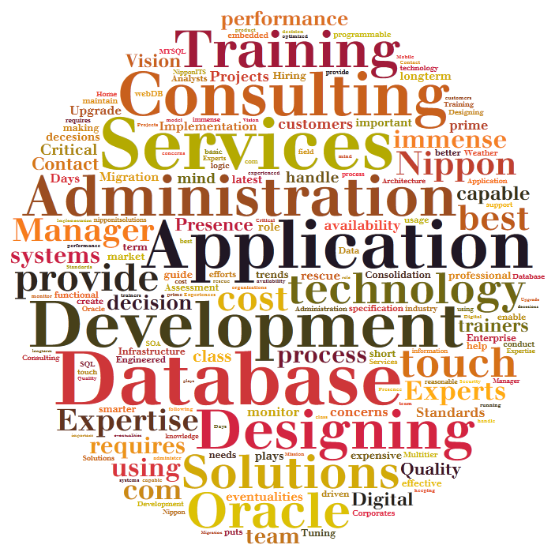



Database Services Offering
Year 2015

Slide 2





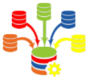

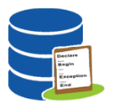

Administration Remote/onsite/Shared/Dedicated
Database Implementation
Database Migration and Upgrade
Database Assessment and performance tuning
Database Consolidation
Database Infrastructure and Oracle Engineered Systems
Database Designing and development
Database

Slide 3
Why DBA services from Nippon ITS?
Migration
And
Upgrade
24 X 7 X 365 Database Support
Performance Bottlenecks
Backup Recovery Support
Proactive Support
Storage Management
User Management
Round the clock DBA Availability
Single point of contact for each shift.
Experience and Expertise of team of DBAs at cost of 1
Providing daily / weekly reports of database issues
Solution for different Database Product under one roof.
Industry Experience / Certified DBAs
Strictly follows customer’s security guidelines
We maintain confidentiality of Customer data.
Suggesting how can we get more out of existing infrastructure.
Database

Slide 4
Database Administration Offering Models
Remote DBA – From Nippon ITS locations
Dedicated Services – Dedicated Team of DBA Assigned
Shared Services – A team of DBA maintaining Multiple Client Database.
Onsite DBA – At Client Side Dedicated DBA
On Demand – Vacation DBA – For existing customers w=if they need project based ramp up or when their primary DBA is on Vacation.
Staffing Services – Provide DBA as Contract to Hire.
Database
Why Remote DBA?
Why Dedicated DBA?
Saving in Infrastructure cost ,Recruitment , Training cost and payroll costs
Multiple Shift resources taken care by us.
SME available for inability of frontline DBAs
Multiple platforms support.
Multiple Products Support
Complex Projects or Development Setups
High availability Requirements
Walking support required by Client teams
Unstable Environments
Heterogeneous Environments
Initial Implementation.
One Dedicated DBA at onsite as point of contact.

Slide 5
Methodology
Database
Team of DBA will be getting tickets and alerts from database systems.
They will login to database environment using VPN service of client.
They will be able to access database system using virtual machine in environment.
All related approvals will be requested by Contract management team and approved by customer SPOC

Slide 6







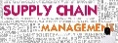
Customer Relationship Management
Service Management
Financial Management
Human Capital Management
Project Portfolio Management
Advance Procurement
Supply Chain Management
Consulting
Designing
Implementation
Development
Global Rollouts
Remote and Onsite Technical Support
Oracle Applications

Slide 7
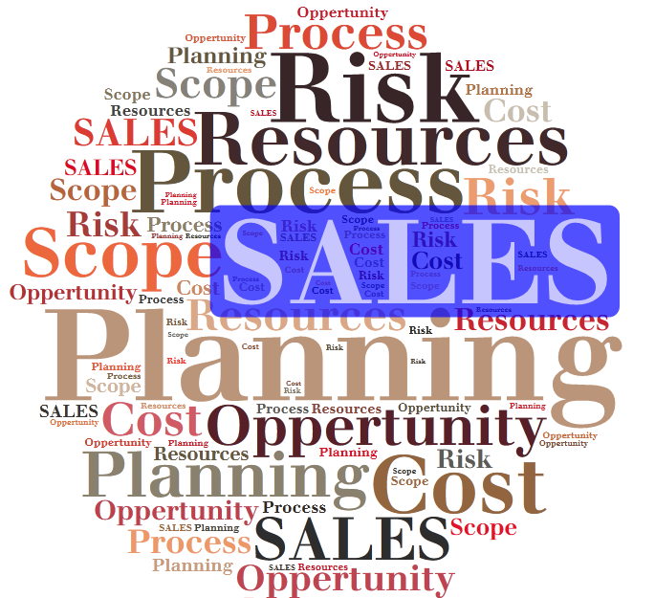
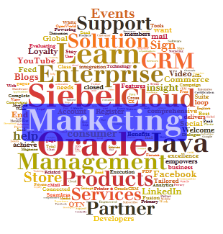
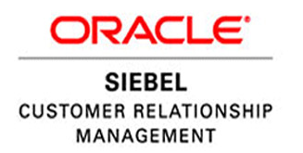
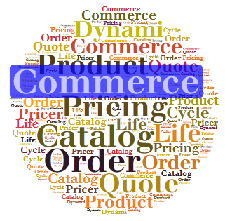
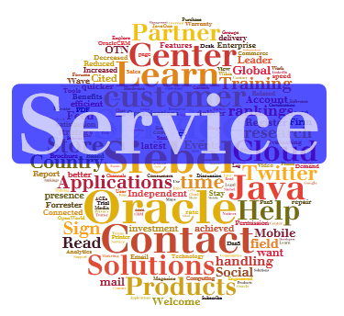
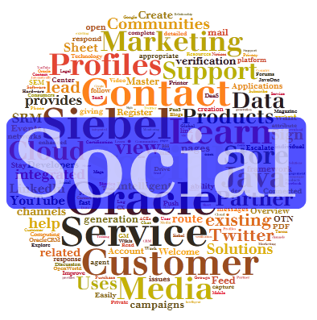
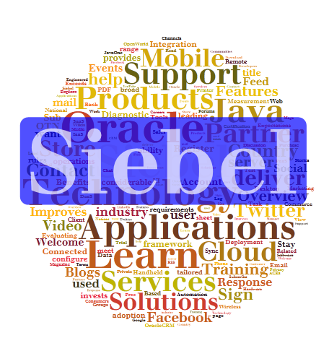
Sales
Marketing
Commerce
Service
Social
Siebel CRM Technology
Consulting
Remote and Onsite Technical Support
Designing
Implementation
Development
Global Rollouts
Oracle Applications

